Slide 1
CODE: 18CSE479T STATISTICAL MACHINE LEARNING UNIT-1

Slide 2
1. Introduction
Why Machine Learning?
Define Machine Learning?
Machine learning is a branch of study in which a model can learn automatically from the experiences based on data without exclusively being modeled like in statistical models. Over a period and with more data, model predictions will become better.
TO LEARN?
- Basic concepts which are necessary to understand both the statistical and machine learning terminology necessary to create a foundation for understanding the similarity between both the streams.
Statistical terminology for model building and validation
Machine learning terminology for model building and validation
Machine learning model overview

Slide 3
2. Statistical terminology for model building and validation
What is Statistics?
Statistics is the branch of mathematics dealing with the collection, analysis, interpretation, presentation, and organization of numerical data.
Statistics Subbrances?
a.) Description Statistics – (Summarize data)
-Mean, standard deviation for continuous data types (age),
-Frequency and percentage are useful for categorical data (gender).
b.) Inferential Statistics
- Every time collection of the entire data is impossible
- Hence a subset of the data points is collected, also called a sample, and conclusions about the entire population will be drawn

Slide 4
What is Statistical Modeling?
Statistical modeling is applying statistics on data to find underlying hidden relationships by analyzing the significance of the variables.

Slide 5
3. Machine Learning
Branch of computer science that utilizes past experience to learn from and use its knowledge to make future decisions.
It is at the intersection of computer science, engineering, and statistics.
Goal
Machine learning is to generalize a detectable pattern or to create an unknown rule from given examples.

Slide 6
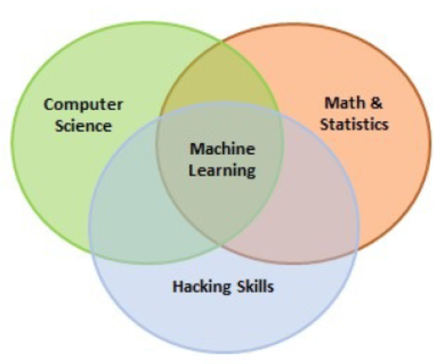
a.) Overview of Machine Learning

Slide 7
b.) Types (or) Classification of Machine Learning
Three categories, based on the situation, these categories can be combined to achieve the desired results for particular applications:
Supervised Learning
This is teaching machines to learn the relationship between other variables and a target variable, similar to the way in which a teacher provides feedback to students on their performance.
The major segments within supervised learning are as follows:
a.) Classification problem
b.) Regression problem

Slide 8
b.) Types (or) Classification of Machine Learning (Cont..)
ii.) Unsupervised learning:
Learn by themselves without any supervision or without any target variable provided.
It is a question of finding hidden patterns and relations in the given data.
Categories in unsupervised learning are as follows:
Dimensionality reduction
Clustering

Slide 9
b.) Types (or) Classification of Machine Learning (Cont..)
iii.) Reinforcement learning:
This allows the machine or agent to learn its behavior based on feedback from the environment.
In reinforcement learning, the agent takes a series of decisive actions without supervision and, in the end, a reward will be given, either +1 or -1.
Based on the final payoff/reward, the agent reevaluates its paths.
Reinforcement learning problems are closer to the artificial intelligence methodology rather than frequently used machine learning algorithms.

Slide 10
c.) Combined types of Machine Learning
In some cases,
we initially perform unsupervised learning to reduce the dimensions followed by supervised learning when the number of variables is very high.
Similarly,
in some artificial intelligence applications, supervised learning combined with reinforcement learning could be utilized for solving a problem;
Example-
self-driving cars in which, initially, images are converted to some numeric format using supervised learning and combined with driving actions - (left, forward, right, and backward).

Slide 11
4. Major differences between statistical modeling and machine learning
Statistical Model | Machine Learning Model
Formalization of relationships between variables in the form of mathematical equations | Algorithm that can learn from the data without relying on rule-based programming.
Required to assume shape of the model curve prior to perform model fitting on the data (for example, linear, polynomial, and so on). | Does not need to assume underlying shape, as machine learning algorithms can learn complex patterns automatically based on the provided data.
Statistical model predicts the output with accuracy of 85 percent and having 90 percent confidence about it | Machine learning just predicts the output with accuracy of 85 percent
In statistical modeling, various diagnostics of parameters are performed, like p-value, and so | Machine learning models do not perform any statistical diagnostic significance tests.

Slide 12
4. Major differences between statistical modeling and machine learning(Cont..)
Statistical Model | Machine Learning Model
Data will be split into 70 percent- 30 percent to create training and testing data. Model developed on training data and tested on testing data. | Data will be split into 50 percent - 25 percent - 25 percent to create training, validation, and testing data. Models developed on training and hyperparameters are tuned on validation data and finally get evaluated against test data.
Statistical models can be developed on a single dataset called training data, as diagnostics are performed at both overall accuracy and individual variable level. | Due to lack of diagnostics on variables, machine learning algorithms need to be trained on two datasets, called training and validation data, to ensure two-point validation
Statistical modeling use- research purposes | Machine learning is very apt for implementation in a production environment.
From the School of statistics and mathematics. | From the School of computer science

Slide 13
5. Steps in machine learning model development and deployment
The development and deployment of machine learning models involves a series of steps that are almost similar to the statistical modeling process.
In order to develop, validate, and implement machine learning models.
The steps are as follows:
1. Collection of Data
2. Data preparation and missing/outlier treatment
3. Data analysis and feature engineering.
4. Train algorithm on training and validation data.
5. Test the algorithm on test data
6. Deploy the algorithm

Slide 14
1.) Collection of Data:
Data for machine learning is collected directly from structured source data, web scrapping, API, chat interaction, and so on.
Machine learning can work on both-
structured and unstructured data
(voice, image, and text).

Slide 15
2.) Data preparation and missing/outlier treatment:
Data is to be formatted as per the chosen machine learning algorithm; also, missing value treatment needs to be performed by replacing missing and outlier values with the mean/median, and so on.

Slide 16
3.) Data analysis and feature engineering:
Data needs to be analyzed in order to find any hidden patterns and relations between variables, and so on.
Correct feature engineering with appropriate business knowledge will solve 70 percent of the problems.
Also, in practice, 70 percent of the data scientist's time is spent on feature engineering tasks.

Slide 17
4.) Train algorithm on training and validation data:
Post feature engineering, data will be divided into three chunks (train, validation, and test data) rather than two (train and test) in statistical modeling.
Machine learning are applied on training data and the hyperparameters of the model are tuned based on validation data to avoid overfitting.

Slide 18
5.) Test the algorithm on test data:
Once the model has shown a good enough performance on train and validation data, its performance will be checked against unseen test data.
If the performance is still good enough, we can proceed to the next and final step.

Slide 19
6.) Deploy the algorithm:
Trained machine learning algorithms will be deployed on live streaming data to classify the outcomes.
Example:
- Recommender systems
implemented by e-commerce websites.

Slide 20
6. Statistical fundamentals and terminology for model building and validation
Predictive analytics - depends on one major assumption- that history repeats itself.
By fitting a predictive model on historical data after validating key measures, the same model will be utilized for predicting future events based on the same explanatory variables that were significant on past data.

Slide 21
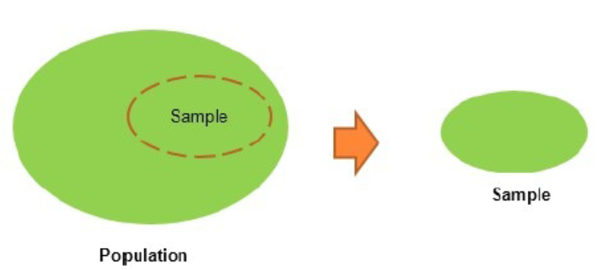
Statistical Fundamentals and Terminologies
Population:
This is the totality, the complete list of observations, or all the
data points about the subject under study.
Sample:
A sample is a subset of a population, usually a small portion of the
population that is being analyzed.

Slide 22
Statistical Fundamentals and Terminologies
Parameter versus statistic:
Any measure that is calculated on the population is a parameter, whereas on a sample it is called a statistic.
Mean:
This is a simple arithmetic average, which is computed by taking the
aggregated sum of values divided by a count of those values. The mean is
sensitive to outliers in the data. An outlier is the value of a set or column
that is highly deviant from the many other values in the same data; it
usually has very high or low values.

Slide 23
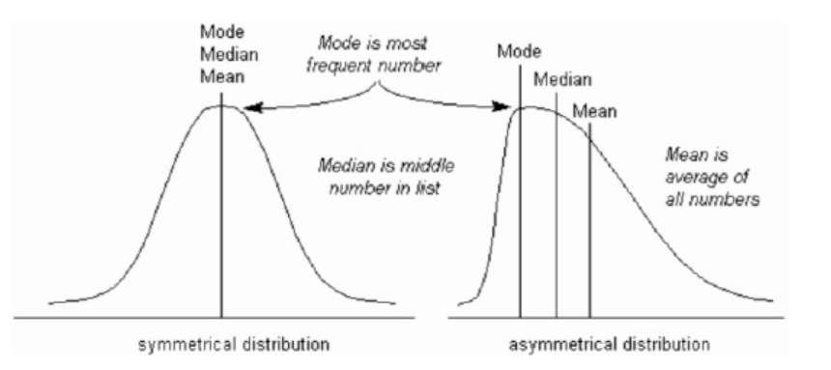
Statistical Fundamentals and Terminologies
Median:
This is the midpoint of the data, and is calculated by either
arranging it in ascending or descending order. If there are N
observations.
Mode:
This is the most repetitive data point in the data:

Slide 24
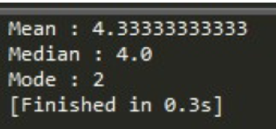
Python Code- (Mean, Median, and Mode) using Numpy array and Stats package
>>> import numpy as np
>>> from scipy import stats
>>> data = np.array([4,5,1,2,7,2,6,9,3])
# Calculate Mean
>>> dt_mean = np.mean(data) ;
print ("Mean :",round(dt_mean,2))
# Calculate Median
>>> dt_median = np.median(data) ;
print ("Median :",dt_median)
# Calculate Mode
>>> dt_mode = stats.mode(data);
print ("Mode :",dt_mode[0][0])

Slide 25
R- Code (Mean, Median, and Mode)
data <- c(4,5,1,2,7,2,6,9,3)
dt_mean = mean(data) ;
print(round(dt_mean,2))
dt_median = median (data);
print (dt_median)
func_mode <- function (input_dt)
{
unq <- unique(input_dt) unq[which.max(tabulate(match(input_dt,unq)))]
}
dt_mode = func_mode (data); print (dt_mode)

Slide 26
Statistical Fundamentals and Terminologies
Measure of variation:
Dispersion is the variation in the data and measures the inconsistencies in the value of variables in the data.
Dispersion actually provides an idea about the spread rather than central values.
Range:
This is the difference between the maximum and minimum of the value.

Slide 27
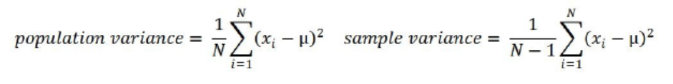
Statistical Fundamentals and Terminologies
Variance:
This is the mean of squared deviations from the mean (xi = data
points, μ = mean of the data, N = number of data points).
The dimension of variance is the square of the actual values.
The reason to use the denominator N-1 for a sample instead of N in the population is due to the degree of freedom.
1 degree of freedom lost in a sample by the time of calculating variance is due to extraction of substitution of sample:

Slide 28
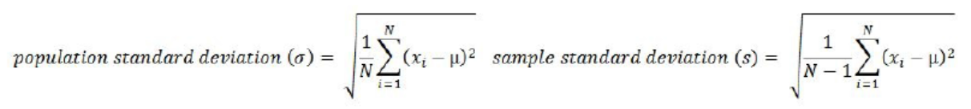
Statistical Fundamentals and Terminologies
Standard deviation:
This is the square root of variance.
By applying the square root on variance, we measure the dispersion with respect to the original variable rather than square of the dimension:

Slide 29
Statistical Fundamentals and Terminologies
Quantiles:
These are simply identical fragments of the data.
Quantiles cover percentiles, deciles, quartiles, and so on.
These measures are calculated after arranging the data in ascending order.
Percentile:
This is nothing but the percentage of data points below the
value of the original whole data. The median is the 50th percentile,
as the number of data points below the median is about 50 percent
of the data.
Decile:
This is 10th percentile, which means the number of data points below the decile is 10 percent of the whole data.

Slide 30
Statistical Fundamentals and Terminologies
Quartile:
This is one-fourth of the data, and also is the 25th percentile. The first quartile is 25 percent of the data, the second quartile is 50 percent of the data, the third quartile is 75 percent of the data. The second quartile is also known as the median or 50th percentile or 5th decile.
Interquartile range:
This is the difference between the third quartile and first quartile. It is effective in identifying outliers in data. The interquartile range describes the middle 50 percent of the data points.

Slide 31
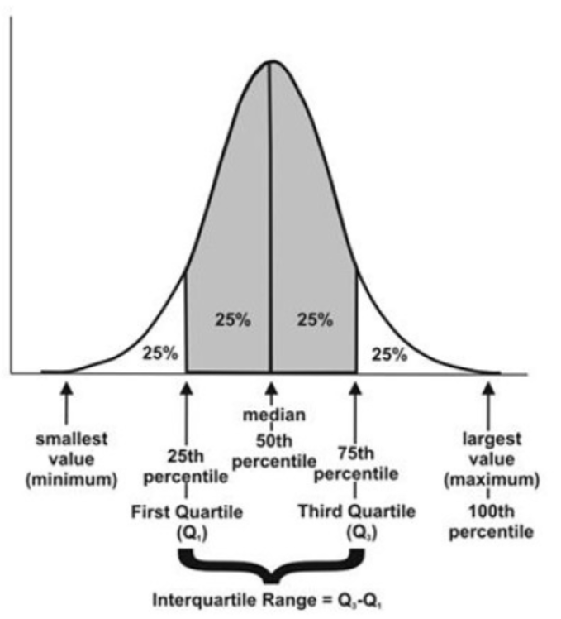
Representation of Quantile

Slide 32
Python Code- Quantiles
>>> from statistics import variance, stdev
>>> game_points = np.array([35,56,43,59,63,79,35,41,64,43,93,60,77,24,82])
# Calculate Variance
>>> dt_var = variance(game_points) ;
print ("Sample variance:", round(dt_var,2))
# Calculate Standard Deviation
>>> dt_std = stdev(game_points) ;
print ("Sample std.dev:", round(dt_std,2))
# Calculate Range
>>> dt_rng = np.max(game_points,axis=0) - np.min(game_points,axis=0) ;
print ("Range:",dt_rng)

Slide 33
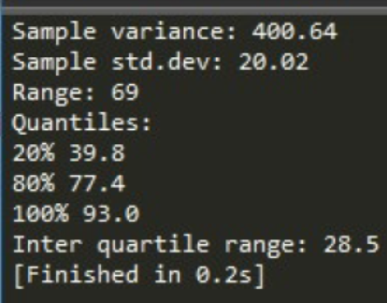
Python Code- Quantiles
#Calculate percentiles
>>> print ("Quantiles:")
>>> for val in [20,80,100]:
>>> dt_qntls = np.percentile(game_points,val)
>>> print (str(val)+"%" ,dt_qntls)
# Calculate IQR
>>> q75, q25 = np.percentile(game_points, [75 ,25]);
print ("Inter quartile range:",q75-q25)

Slide 34
R- Code (Quantiles)
game_points <- c(35,56,43,59,63,79,35,41,64,43,93,60,77,24,82)
dt_var = var(game_points);
print(round(dt_var,2))
dt_std = sd(game_points);
print(round(dt_std,2))
range_val<-function(x) return(diff(range(x)))
dt_range = range_val(game_points);
print(dt_range)
dt_quantile = quantile(game_points,probs = c(0.2,0.8,1.0)); print(dt_quantile)
dt_iqr = IQR(game_points);
print(dt_iqr)

Slide 35
Hypothesis testing:
This is the process of making inferences about the overall population by conducting some statistical tests on a sample.
Null and alternate hypotheses are ways to validate whether an assumption is statistically significant or not.

Slide 36
P-value:
The probability of obtaining a test statistic result is at least as extreme as the one that was actually observed, assuming that the null hypothesis is true.
p-value less than 0.05 is considered significant
P-value greater than 0.05 is considered insignificant.

Slide 37
The steps involved in hypothesis testing are as follows
1. Assume a null hypothesis (usually no difference, no significance, and
so on; a null hypothesis always tries to assume that there is no anomaly
pattern and is always homogeneous, and so on).
2. Collect the sample.
3. Calculate test statistics from the sample in order to verify whether the
hypothesis is statistically significant or not.
4. Decide either to accept or reject the null hypothesis based on the test
static

Slide 38
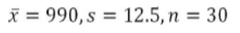
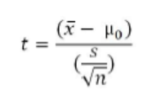
Example of hypothesis testing:
A chocolate manufacturer who is also your friend claims that all chocolates produced from his factory weigh at least 1,000 g and you have got a funny feeling that it might not be true; you both collected a sample of 30 chocolates and found that the average chocolate weight as 990 g with sample standard deviation as 12.5 g.
Given the 0.05 significance level, can we reject the claim made by your friend?
Collected sample:
Calculate test statistic:

Slide 39
Example of hypothesis testing:
t = (990 - 1000) / (12.5/sqrt(30)) = - 4.3818
Critical t value from t tables
= t0.05, 30 = 1.699 => - t0.05, 30 = -1.699
P-value = 7.03 e-05
Test statistic is -4.3818, which is less than the critical value of -1.699.
Hence, we can reject the null hypothesis (your friend's claim) that the mean weight of a chocolate is above 1,000 g.

Slide 40
Type I and II error:
Hypothesis testing is usually done on the samples rather than the entire population, due to the practical constraints of available resources to collect all the available data.
Type I error: Rejecting a null hypothesis when it is true
Type II error: Accepting a null hypothesis when it is false.

Slide 41
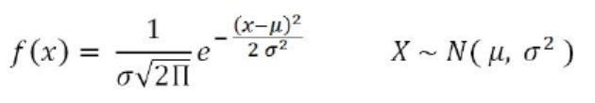
Normal distribution:
This is very important in statistics because of the central limit theorem, which states that the population of all possible samples of size n from a population with mean μ and variance σ2 approaches a normal distribution:

Slide 42
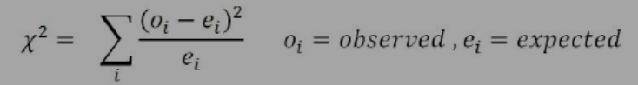
Chi-square:
This test of independence is one of the most basic and common hypothesis tests in the statistical analysis of categorical data.
Given two categorical random variables X and Y, the chi-square test of independence determines whether or not there exists a statistical dependence between them.

Slide 43
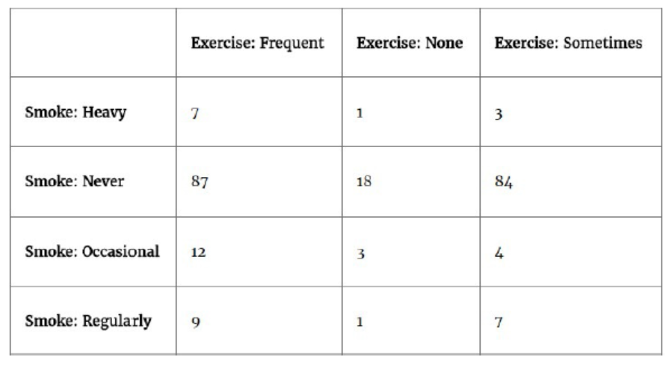
Example: In the following table, calculate whether the smoking habit has an impact on exercise behavior:

Slide 44
ANOVA:
Analyzing variance tests the hypothesis that the means of two or more populations are equal.
ANOVAs assess the importance of one or more factors by comparing the response variable means at the different factor levels.
The null hypothesis states that all population means are equal while the alternative hypothesis states that at least one is different.

Slide 45
ANOVA-Example
Example:
A fertilizer company developed three new types of universal fertilizers after research that can be utilized to grow any type of crop. In order to find out whether all three have a similar crop yield, they randomly chose six crop types in the study. In accordance with the randomized blockdesign, each crop type will be tested with all three types of fertilizerseparately. The following table represents the yield in g/m2. At the 0.05level of significance, test whether the mean yields for the three new types of fertilizers are all equal:

Slide 46
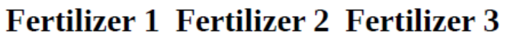
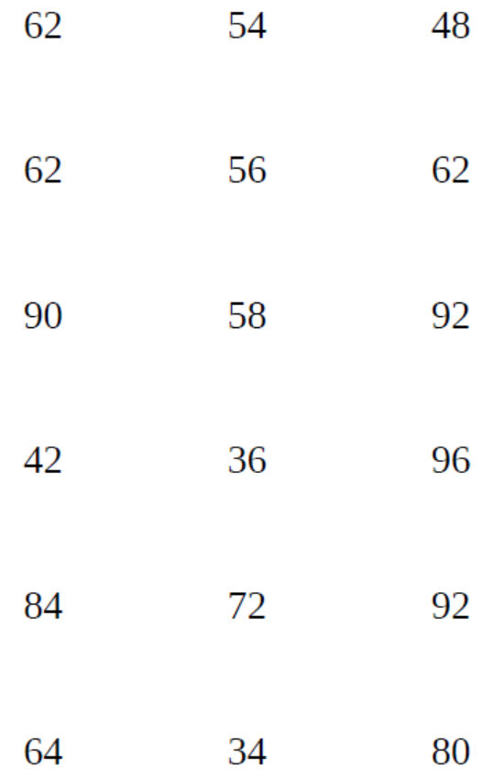

Slide 47
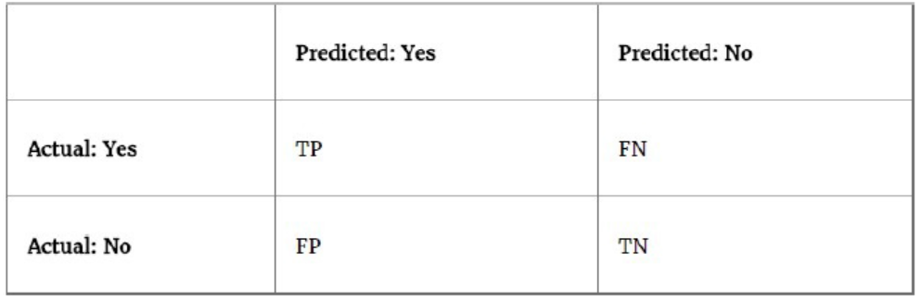
Confusion matrix:
This is the matrix of the actual versus the predicted.
This concept is better explained with the example of cancer prediction using the model:

Slide 48
Confusion matrix:
True positives (TPs): True positives are cases when we predict the disease as yes when the patient actually does have the disease.
True negatives (TNs): Cases when we predict the disease as no when the patient actually does not have the disease.
False positives (FPs): When we predict the disease as yes when the patient actually does not have the disease. FPs are also considered to be type I errors.
False negatives (FNs): When we predict the disease as no when the patient actually does have the disease. FNs are also considered to be type II errors.
Precision (P): When yes is predicted, how often is it correct?
(TP/TP+FP)

Slide 49
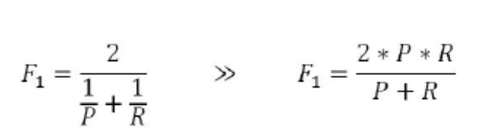
F1 score (F1):
This is the harmonic mean of the precision and recall.
Multiplying the constant of 2 scales the score to 1 when both precision and recall are 1:
Specificity: Among the actual nos, what fraction was predicted as no?
Also equivalent to 1- false positive rate:
(TN/TN+FP)

Slide 50
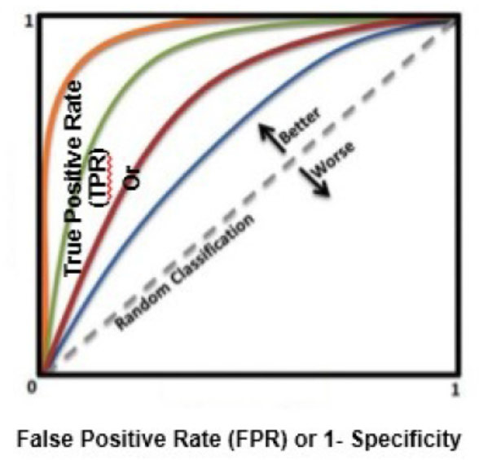
Area under curve (ROC):
Receiver operating characteristic curve is used to plot between true positive rate (TPR) and false positive rate (FPR), also known as a sensitivity and 1- specificity graph:

Slide 51
OBSERVATION AND PERFORMANCE WINDOW:
Tries to predict the event in advance rather than at the moment, so that some buffer time will exist to work on corrective actions.
For example,
question from a credit card company would be, for example, what is the probability that a particular customer will default in the coming 12-month period?
So that I can call him and offer any discounts or develop my collection strategies accordingly.

Slide 52
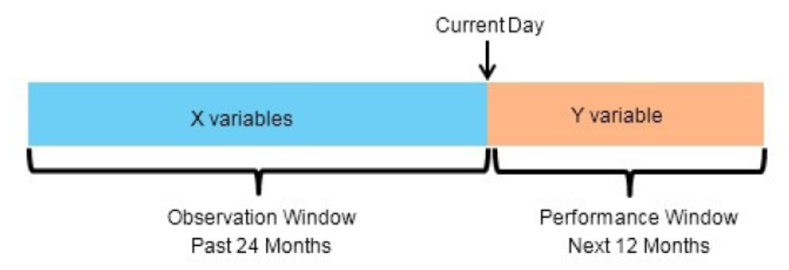
OBSERVATION AND PERFORMANCE WINDOW

Slide 53
In-time and out-of-time validation:
In-time validation implies obtaining both a training and testing dataset from the same period of time, whereas out-of-time validation implies training and testing datasets drawn from different time periods.
Usually, the model performs worse in out-of-time validation rather than in-time due to the obvious reason that the characteristics of the train and test datasets might differ

Slide 54
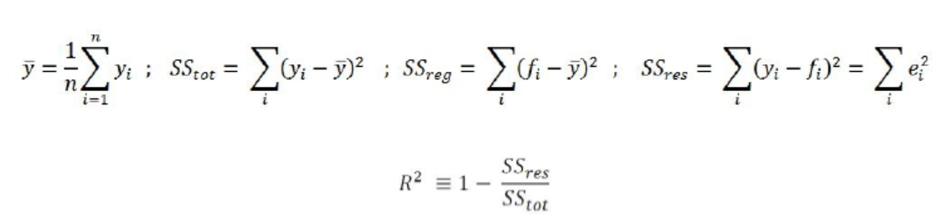
R-squared (coefficient of determination):
This is the measure of the percentage of the response variable variation that is explained by a model.
It also a measure of how well the model minimizes error compared with just utilizing the mean as an estimate.
R-squared can have a value less than zero also, which means the predicted values from the model perform worse than just taking the simple mean as a prediction for all the observations.

Slide 55
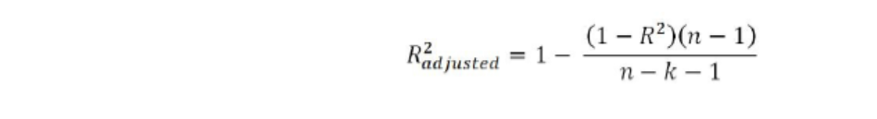
Adjusted R-squared:
The explanation of the adjusted R-squared statistic is
almost the same as R-squared but it penalizes the R-squared value if extra
variables without a strong correlation are included in the model:
Here, R2 = sample R-squared value, n = sample size, k = number of predictors (or) variables

Slide 56
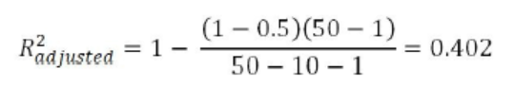
Why Adjusted R-squared
Adjusted R-squared value is the key metric in evaluating the quality of linear regressions.
Any linear regression model having the value of R2 adjusted >= 0.7 is considered as a good enough model to implement.
Example:
The R-squared value of a sample is 0.5, with a sample size of 50 and the independent variables are 10 in number.
Calculated adjusted Rsquared:

Slide 57
Maximum likelihood estimate (MLE):
This is estimating the parameter values of a statistical model (logistic regression, to be precise) by finding the parameter values that maximize the likelihood of making the observations.

Slide 58
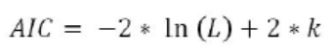
Akaike information criteria (AIC):
This is used in logistic regression, which is similar to the principle of adjusted R-square for linear regression.
It measures the relative quality of a model for a given set of data:
Here, k = number of predictors or variables

Slide 59
Entropy:
This comes from information theory and is the measure of impurity in the data. If the sample is completely homogeneous, the entropy is zero and if the sample is equally divided, it has an entropy of 1.
In decision trees, the predictor with the most heterogeneousness will be considered nearest to the root node to classify given data into classes in a greedy mode.
Here, n = number of classes. Entropy is maximal at the middle, with the value of 1 and minimal at the extremes as 0. A low value of entropy is desirable as it will segregate classes better

Slide 60
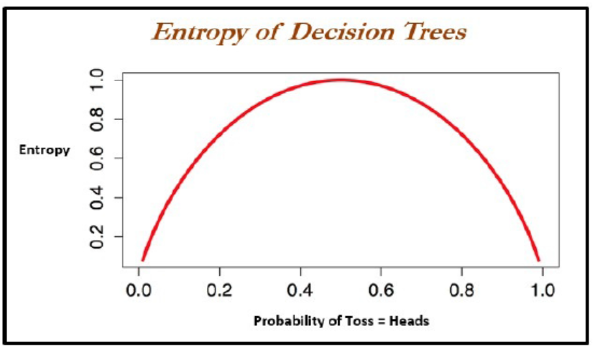

Slide 61
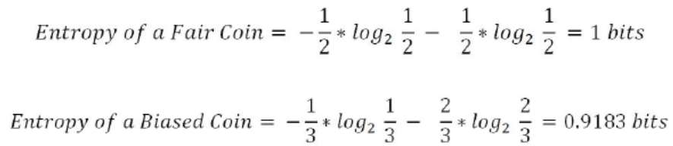
Example- Entropy
Given two types of coin in which the first one is a fair one (1/2 head and 1/2 tail probabilities) and the other is a biased one (1/3 head and 2/3 tail probabilities), calculate the entropy for both and justify which one is better with respect to modeling:
From both values, the decision tree algorithm chooses the biased coin rather than the fair coin as an observation splitter due to the fact the value of entropy is less.

Slide 62
Information gain:
This is the expected reduction in entropy caused by partitioning the examples according to a given attribute.
The idea is to start with mixed classes and to keep partitioning until each node reaches its observations of the purest class.
At every stage, the variable with maximum information gain is chosen in greedy fashion:
Information gain = Entropy of parent - sum (weighted % * Entropy of child)
Weighted % = Number of observations in particular child / sum (observations in all child nodes)

Slide 63
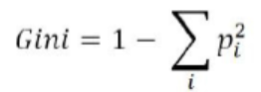
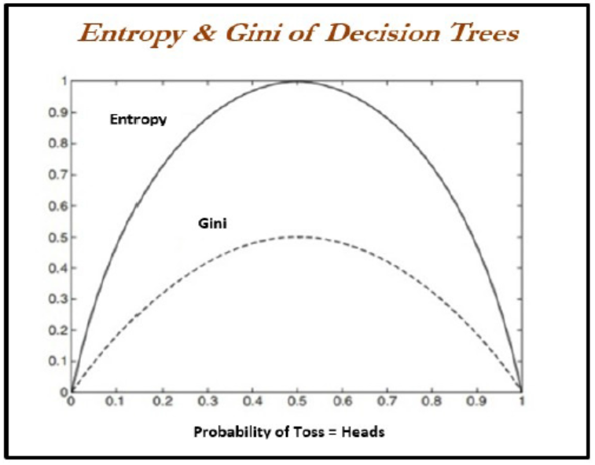
Gini:
Gini impurity is a measure of misclassification, which applies in a multiclass classifier context. Gini works almost the same as entropy, except, Gini is faster to calculate:
Here, i = number of classes

Slide 64
Bias vs Variance Trade-off
Every model – Bias & Variance Error components + Noise.
Bias & Variance are inversely related to each other.
One component trying to reduce and other component increase.
True art lies creating good fit by balance both
Ideal Model= Low Bias + Low Variance.
<algorithm miss relevant relations b/w features & Target outputs>
High Bias -----> cause – Underfitting problem.
High Variance ----> cause – Overfitting Problem.

Slide 65

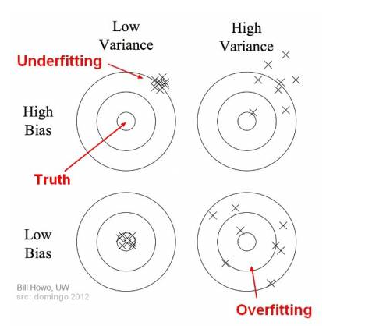
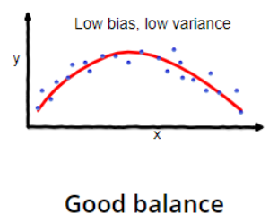
Bias vs Variance Trade-off (Cont..,)
(i) Underfitting Vs Overfitting Data

Slide 66

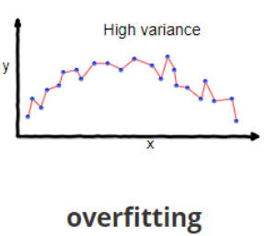
Bias vs Variance Trade-off (Cont..,)
a.) Overfitting Data in Machine Learning Model :
when a model learns the training set too well.
taking up random fluctuations in the training data as concepts.
These impact the model’s ability to generalize and don’t apply to new data.
When Data occurs Overfitting?
When a model is given the training data, it shows 100 percent accuracy.
But, when we use the test data, there may be an error and low efficiency.
How to avoid Overfitting Data in a Model?
(i) Regularization
(ii) Cross-validation methods
(iii) Ensemble
(iv) Removing Features

Slide 67
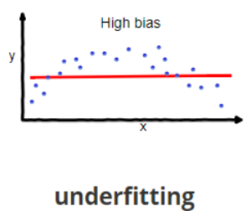
Bias vs Variance Trade-off (Cont..,)
b.) Underfitting Data in Machine Learning Model :
High bias error means that that model we are using is ignoring all the important trends in the model and the model is underfitting.
When Data occurs Underfitting?
Sometimes it also gives the impression that the data is noisy.
noisy data should be removed so that most important signals are found by the model to make effective predictions.
Increasing the number of epochs results in increasing the duration of training of the model. It’s helpful in reducing the error.
How to avoid Underfitting Data in a Model?
We need to increase the complexity of the model.
Number of features need to be increased

Slide 68
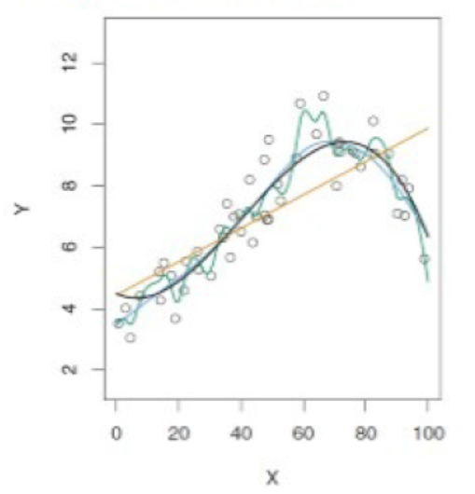
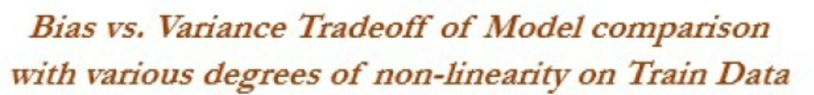
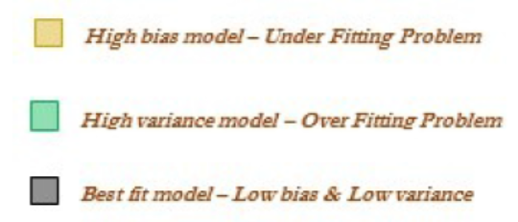
Bias vs Variance Trade-off (Cont..,)
Example : –
High Bias ==> Logistic Regression/ Linear Regression.
High Variance ==> Decision Tree

Slide 69
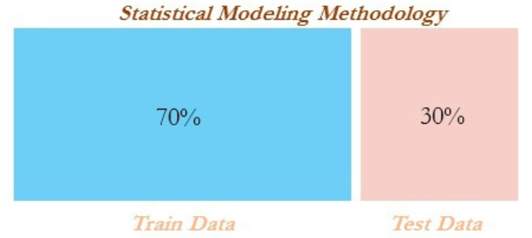
Train & Test Data
data usually will be split randomly 70-30 or 80-20 into train and test
datasets respectively in statistical modeling, in which training data utilized for
building the model and its effectiveness will be checked on test data

Slide 70
Train & Test Data
we split the original data into train and test data by 70 percent - 30 percent.
An important point to consider here is that we set the seed values for random numbers in order to repeat the random sampling every time
we create the same observations in training and testing data. Repeatability is very much needed in order to reproduce the results:
# Train & Test split
>>> import pandas as pd
>>> from sklearn.model_selection import train_test_split
>>> original_data = pd.read_csv("mtcars.csv")
>>> train_data,test_data = train_test_split(original_data,train_size = 0.7, test_size=0.3)

Slide 71
Machine Learning Losses
The loss function or cost function in machine learning is a function that maps the values of variables onto a real number intuitively representing some cost associated with the variable values.
Optimization methods are applied to minimize the loss function by changing the parameter values, which is the central theme of machine learning.
Zero-one loss is L0-1 = 1 (m <= 0) in zero-one loss.
<value of loss is 0 for m >= 0>
<value of loss is 1 for m <= 0>
The difficult part with this loss is it is not differentiable, non-convex, and also NP-hard.

Slide 72
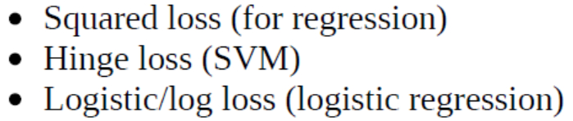
Machine Learning Losses
losses used for machine learning in place of zero-one loss are given as follows. The zero-one loss is not differentiable, hence approximated losses are being used instead.

Slide 73
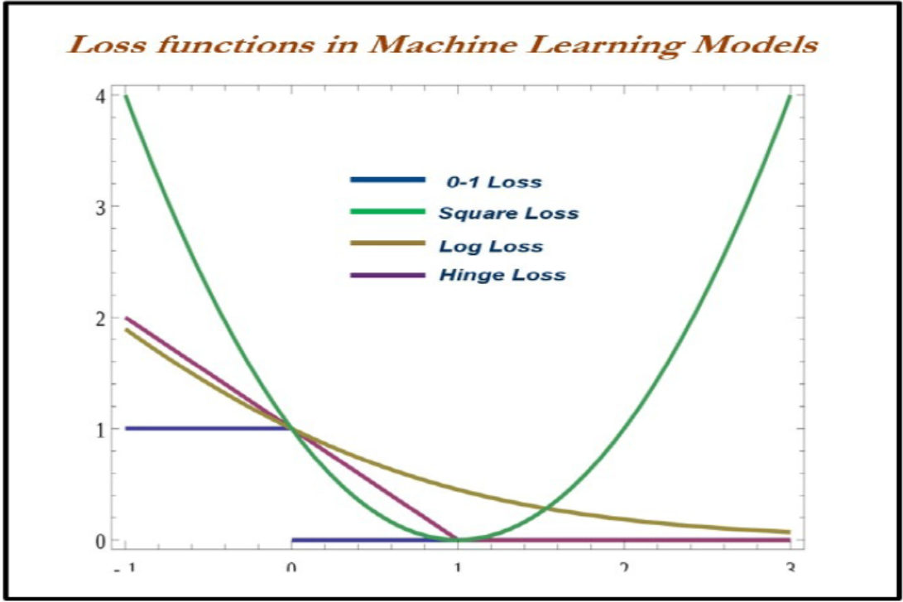

Slide 74
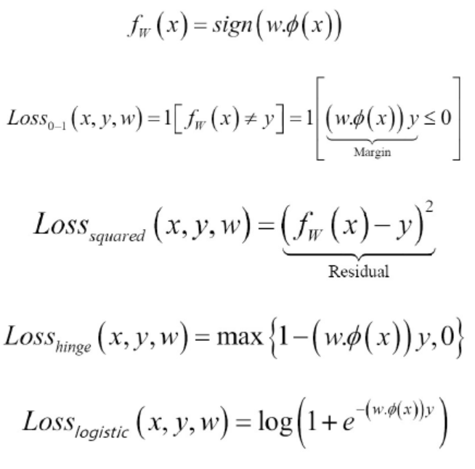

Slide 75
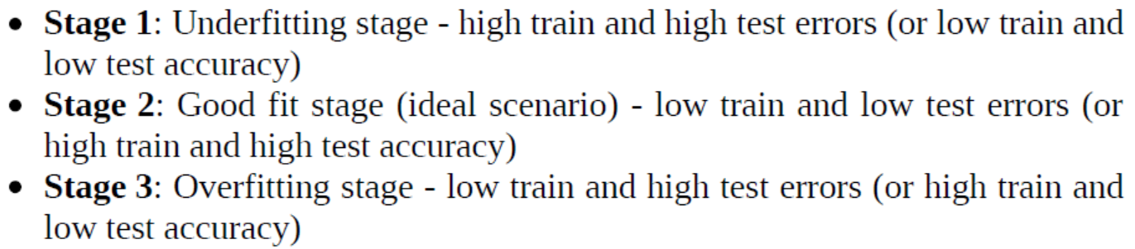
When to stop tuning machine learning models
When to stop tuning the hyperparameters in a machine learning model.
This problem can be mostly solved by keeping tabs on training and testing errors. While increasing the complexity of a model, the following stages occur:

Slide 76
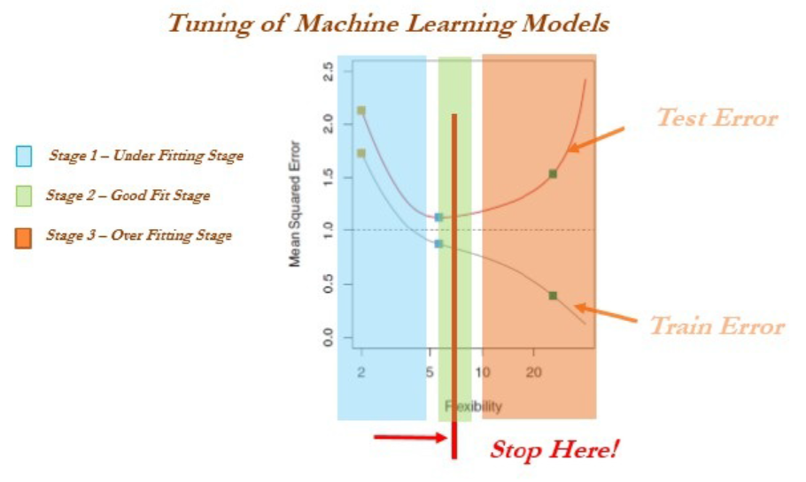

Slide 77
Train, validation, and test data
Cross-validation is not popular in the statistical modeling world for many reasons.
Statistical models are linear in nature and robust, and do not have a high variance/overfitting problem.
Hence, the model fit will remain the same either on train or test data, which does not hold true in the machine learning world.
In statistical modeling, lots of tests are performed at the individual parameter level apart from aggregated metrics.
whereas in machine learning we do not have visibility at the individual parameter level

Slide 78
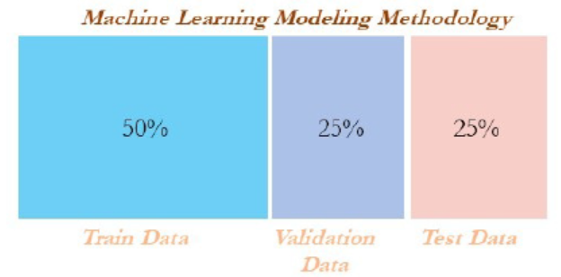

Slide 79
Cross-validation
Cross-validation is another way of ensuring robustness in the model at the expense of computation.
In the ordinary modeling methodology, a model is developed on train data and evaluated on test data.
In some extreme cases, train and test might not have been homogeneously selected.
some unseen extreme cases might appear in the test data, which will drag down the performance of the model.

Slide 80
Cross-validation
cross-validation methodology, data was divided into equal parts and training performed on all the other parts of the data except one part, on which performance will be evaluated.
This process repeated as many parts user has chosen.

Slide 81
Cross-validation- (Example)
In five-fold cross-validation, data will be divided into five parts,
subsequently trained on four parts of the data, and tested on the one part of the
data. This process will run five times, in order to cover all points in the data.
Finally, the error calculated will be the average of all the errors

Slide 82
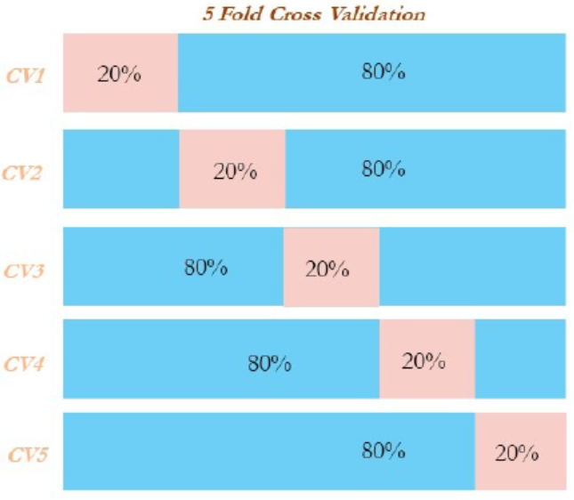
Cross-validation- (Example)

Slide 83
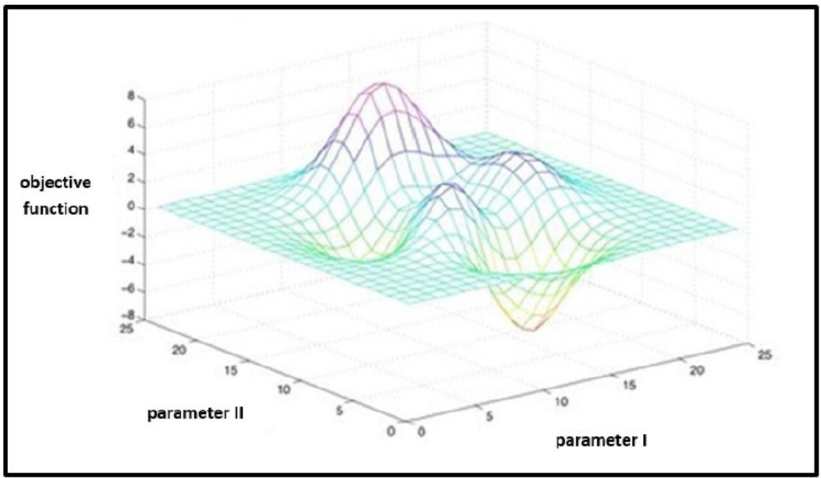
GRID Search
Grid search in machine learning is a popular way to tune the hyperparameters of the model in order to find the best combination for determining the best fit.

Slide 84
GRID Search
Grid search has been implemented using a decision tree classifier for classification purposes.
Tuning parameters are the depth of the tree, the minimum number of observations in terminal node, and the minimum number of observations required to perform the node split.
Grid-search is used to find the optimal hyperparameters of a model which results in the most ‘accurate’ predictions.

Slide 85
Machine learning model overview
Machine learning models are classified mainly into
Supervised learning
Unsupervised learning
Reinforcement learning.

Slide 86
a.) Supervised learning:
This is where an instructor provides feedback to a student on whether they have performed well in an examination or not.
Classification problems
Logistic regression
Lasso and ridge regression
Decision trees (classification trees)
Bagging classifier
Random forest classifier
Boosting classifier (adaboost, gradient boost, and xgboost)

Slide 87
b.) Supervised learning:
SVM classifier
Recommendation engine
Regression problems
Linear regression (lasso and ridge regression)
Decision trees (regression trees)
Bagging regressor
Random forest regressor
Boosting regressor - (adaboost, gradient boost, and xgboost)
SVM regressor

Slide 88
c.) Unsupervised learning:
Similar to the teacher-student analogy, in which the instructor does not present and provide feedback to the student and who needs to prepare on his/her own.
Unsupervised learning does not have as many are in supervised learning:
Principal component analysis (PCA)
K-means clustering

Slide 89
d.) Reinforcement learning:
This is the scenario in which multiple decisions need to be taken by an agent prior to reaching the target and it provides a reward, either +1 or -1, rather than notifying how well or how badly the agent performed across the path:
Markov decision process
Monte Carlo methods
Temporal difference learning

Slide 90
Logistic regression
Discrete classes rather than continuous values.
For example,
customer will arrive or not, he will purchase the product or not, and so on.
In statistical methodology - maximum likelihood method to calculate the parameter of individual variables.
In machine learning methodology - log loss will be minimized with respect to β coefficients (also known as weights).
Logistic regression has a high bias and a low variance error.

Slide 91
Linear regression:
Prediction of continuous variables such as customer income and so on.
It utilizes error minimization to fit the best possible line in statistical methodology.
In machine learning methodology, squared loss will be minimized with respect to β coefficients.
Linear regression also has a high bias and a low variance error.

Slide 92
Lasso and ridge regression:
This uses regularization to control overfitting issues by applying a penalty on coefficients.
In ridge regression - a penalty is applied on the sum of squares of coefficients, whereas
In lasso - a penalty is applied to the absolute values of the coefficients.
The penalty can be tuned in order to change the dynamics of the model fit.
Ridge regression tries to minimize the magnitude of coefficients, whereas lasso tries to eliminate them

Slide 93
Decision trees:
Recursive binary splitting is applied to split the classes at each level to classify observations to their purest class.
The classification error rate is simply the fraction of the training observations in that region that do not belong to the most common class.
Decision trees have an overfitting problem due to their high variance in a way to fit; pruning is applied to reduce the overfitting problem by growing the tree completely.
Decision trees have low a bias and a high variance error.

Slide 94
Bagging:
This is an ensemble technique applied on decision trees in order to minimize the variance error and at the same time not increase the error component due to bias.
various samples are selected with a subsample of observations and all variables (columns), subsequently fitting individual decision trees independently on each sample and later ensemble the results by taking the maximum vote (in regression cases, the mean of outcomes calculated).

Slide 95
Random forest:
This is similar to bagging except for one difference.
All the variables/columns are selected for each sample, whereas in the random forest a few sub-columns are selected.
The reason behind the selection of a few variables rather than all was that during each independent tree sampled.
significant variables always came first in the top layer of splitting which makes all the trees look more or less similar and defies the sole purpose of ensemble
It works better on diversified and independent individual models rather than correlated individual models.
Random forest has both low bias and variance errors.

Slide 96
Boosting:
This is a sequential algorithm that applies on weak classifiers such as a decision stump (a one-level decision tree or a tree with one root node and two terminal nodes)
To create a strong classifier by ensembling the results.
The algorithm starts with equal weights assigned to all the observations, followed by subsequent iterations where more focus was given to misclassified observations by increasing the weight of misclassified observations and decreasing the weight of properly classified observations.
In the end, all the individual classifiers were combined to create a strong classifier.
Boosting might have an overfitting problem, but by carefully tuning the parameters, we can obtain the best of the self machine learning model.

Slide 97
Support vector machines (SVMs):
This maximizes the margin between classes by fitting the widest possible hyperplane between them.
In the case of non-linearly separable classes, it uses kernels to move observations into higher-dimensional space and then separates them linearly with the hyperplane there.

Slide 98
Recommendation engine:
This utilizes a collaborative filtering algorithm to identify high-probability items to its respective users, who have not used it in the past, considering the tastes of similar users who would be using that particular item.
It uses the Alternating Least Squares (ALS) methodology to solve this problem.

Slide 99
Principal component analysis (PCA):
This is a dimensionality reduction technique in which principal components are calculated in place of the original variable.
Principal components are determined where the variance in data is maximum; subsequently, the top n components will be taken by covering about 80 percent of variance and will be used in further modeling processes, or exploratory analysis will be performed as unsupervised learning.

Slide 100
K-means clustering:
This is an unsupervised algorithm that is mainly utilized for segmentation exercises.
K-means clustering classifies the given data into k clusters in such a way that, within the cluster, variation is minimal and across the cluster, variation is maximal

Slide 101
Markov decision process (MDP):
In reinforcement learning, MDP is a mathematical framework for modeling decision-making of an agent in situations or environments where outcomes are partly random and partly under control.
In this model, the environment is modeled as a set of states and actions that can be performed by an agent to control the system's state.
The objective is to control the system in such a way that the agent's total payoff is maximized.

Slide 102
Monte Carlo method:
Monte Carlo methods do not require complete knowledge of the environment, in contrast with MDP.
Monte Carlo methods require only experience, which is obtained by sample sequences of states, actions, and rewards from actual or simulated interaction with the environment.
Monte Carlo methods explore the space until the final outcome of a chosen sample sequences and update estimates accordingly.

Slide 103
Temporal difference learning:
This is a core theme in reinforcement learning.
Temporal difference is a combination of both Monte Carlo and dynamic programming ideas.
Similar to Monte Carlo, temporal difference methods can learn directly from raw experience without a model of the environment's dynamics.
Like dynamic programming, temporal difference methods update estimates based in part on other learned estimates, without waiting for a final outcome.
Temporal difference is the best of both worlds and is most commonly used in games such as AlphaGo and so on.

